Slide 1





Welcome to Our Airline Booking Portal
This presentation provides an overview of an airline booking portal, exploring its purpose, functionalities . The project aims to simplify and enhance the travel booking experience.
Prepared by: Om Prajapati
Enroll no: 23002171510029

Slide 2
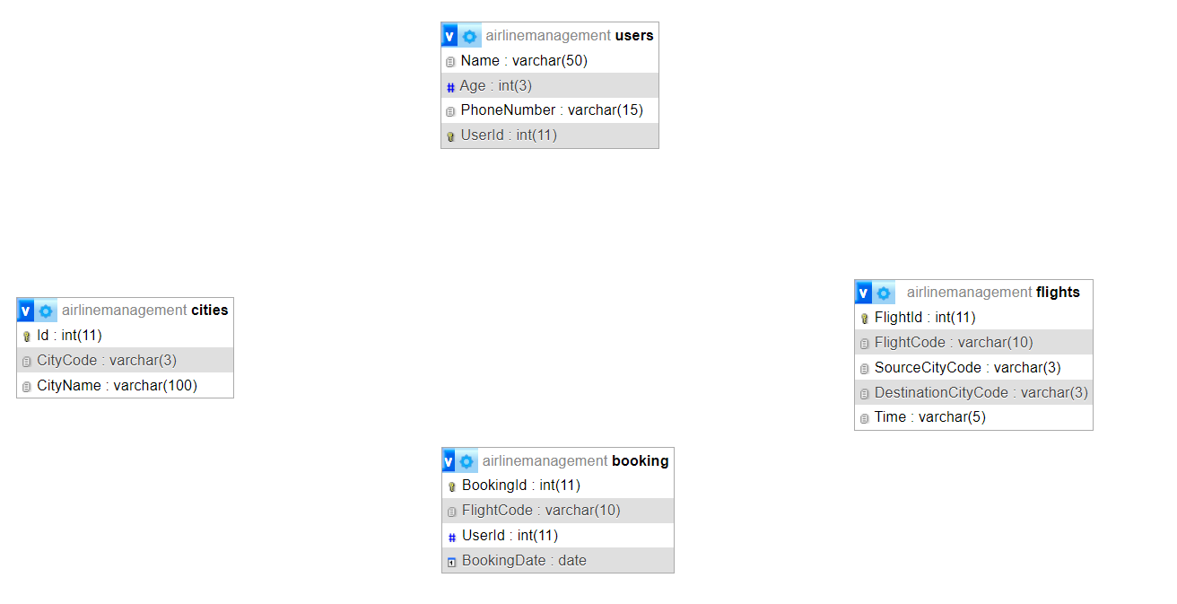
Class Diagram

Slide 3
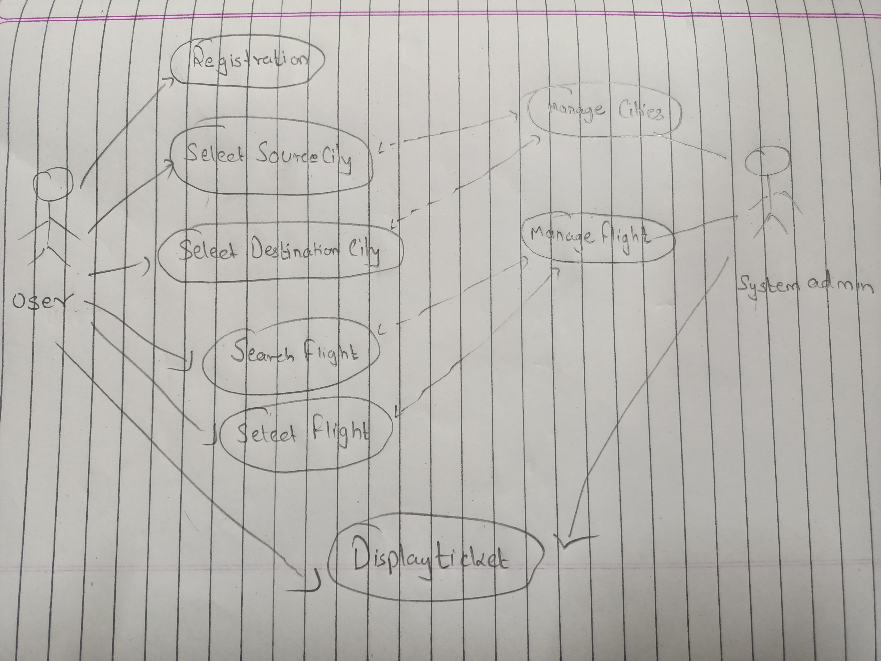
Use Case Diagram

Slide 4
Functionalities used
1
Java
2
3
Data Structures
Database Management System
OOP concepts (classes, objects
Exception Handling (try, catch)
Array List (for storing data)
SQL Queries (for retrieving data from database)
:JDBC (Java Database Connectivity)

Slide 5





Merits
Enhanced Customer Experience
The portal provides a convenient and user-friendly
experience for customers to book flights online.
Increased Efficiency
The booking process reduces manual effort and saves time for both custome automatedrs and airline staff.
Wide Range of Options
Multiple flights and time can be accessible by sitting at
one place making it easier for the customer

Slide 6

Demerits
Complexity in Booking Management
Managing and reflecting changes in bookings, like
cancellations or rescheduling, can be complex
Security Concerns
Contains sensitive information like personal details, and travel plans. Any security breach could lead to data theft or misuse.
Limited Personalization
The system may lack advanced personalization features,
leading to less relevant flight recommendations and
offers for users.

Slide 7
Thank You

